Slide 1


The Exclusive Web 3.0 Live-Streaming Service Platform
Notes:
Cover

Slide 2
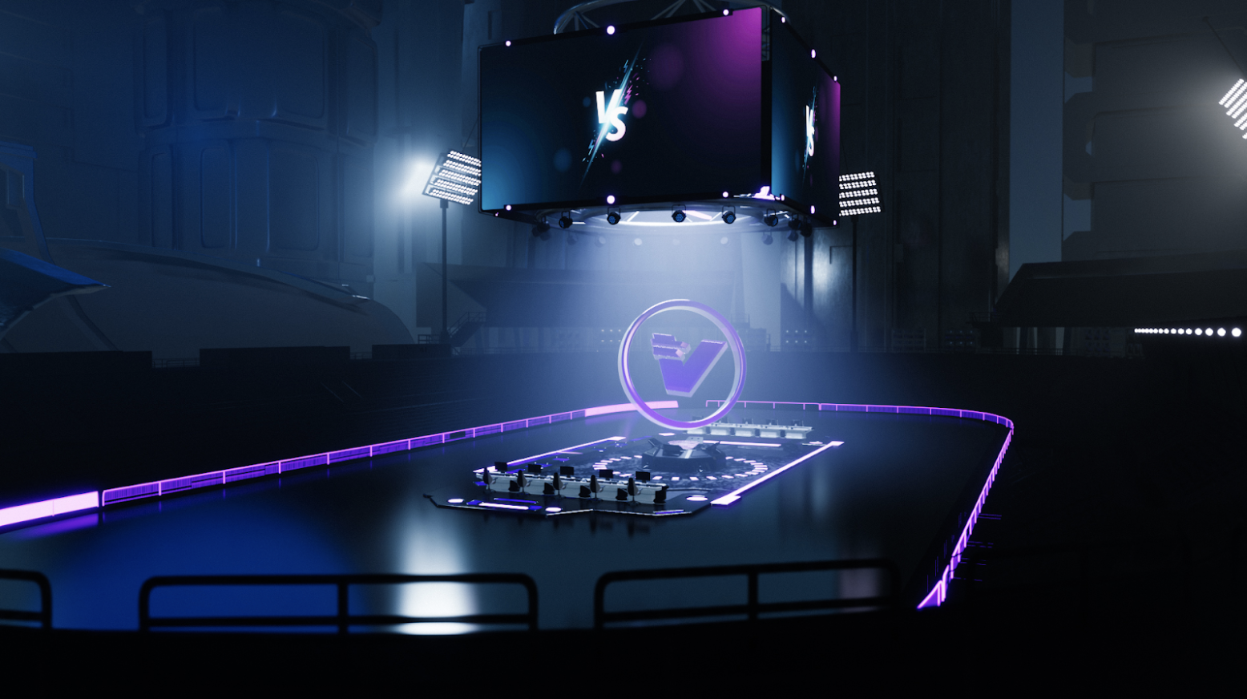



ETH / Polygon / Solana
Decentralized
Live-Streaming
Platform
AI Avatar Generator
NFT Mask SDK
KOLs
PC / iOS / Android
Live-Streaming SDK
Users
PC / iOS / Android
CDN
(Content Delivery Network)
Live-Steaming
Service
CDN
(Content Delivery Network)
RTMP Server
Live-Streaming Centre
(IPFS+RTMP)
IPFS Server
Filecoin: File.Video
Notes:
Platform Techniques 2

Slide 3

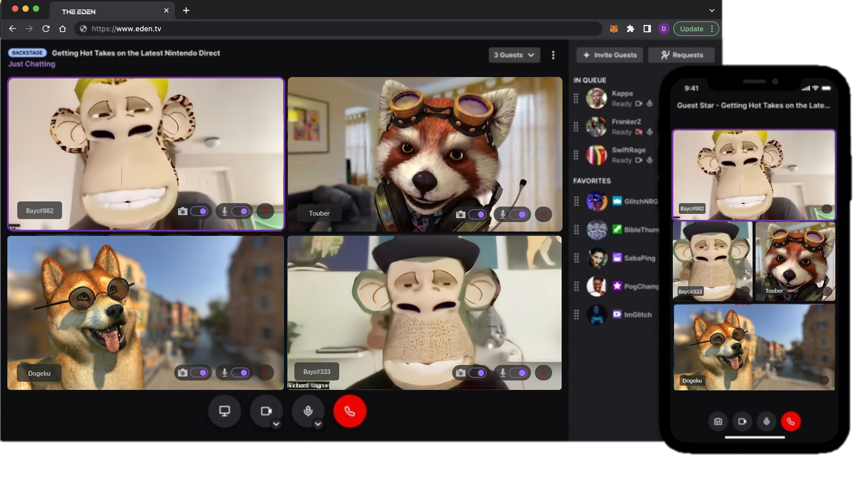
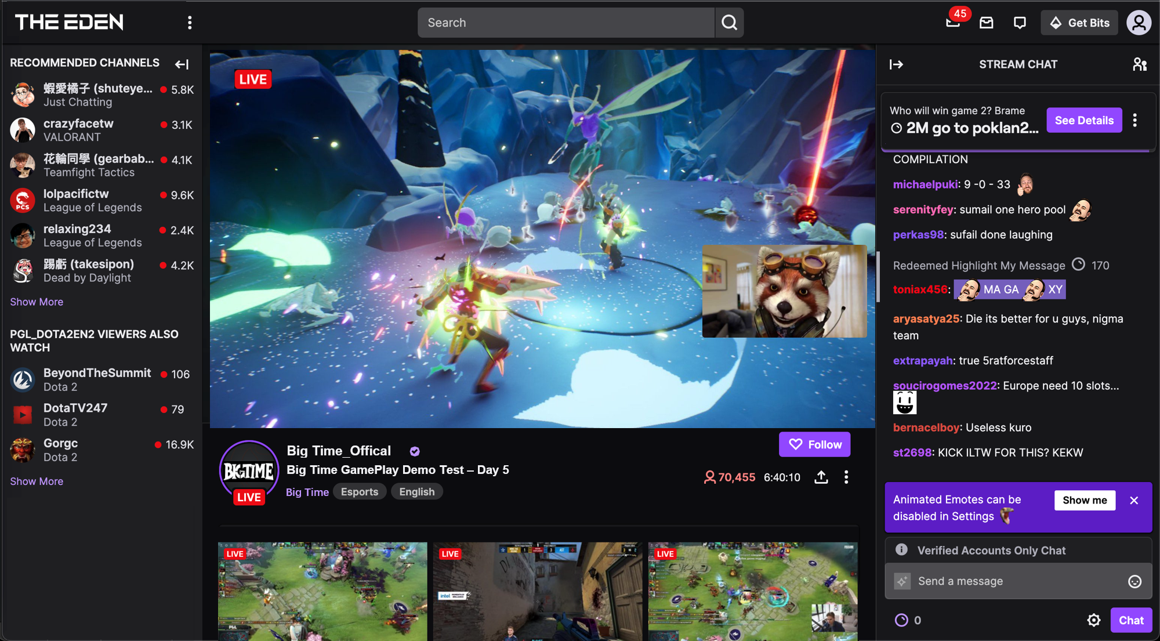
3D NFT Avatar AMA
Supported by Multi-Platform
3D Avatar KOL for Gamefi Live-Streaming
Notes:
Service

Slide 4
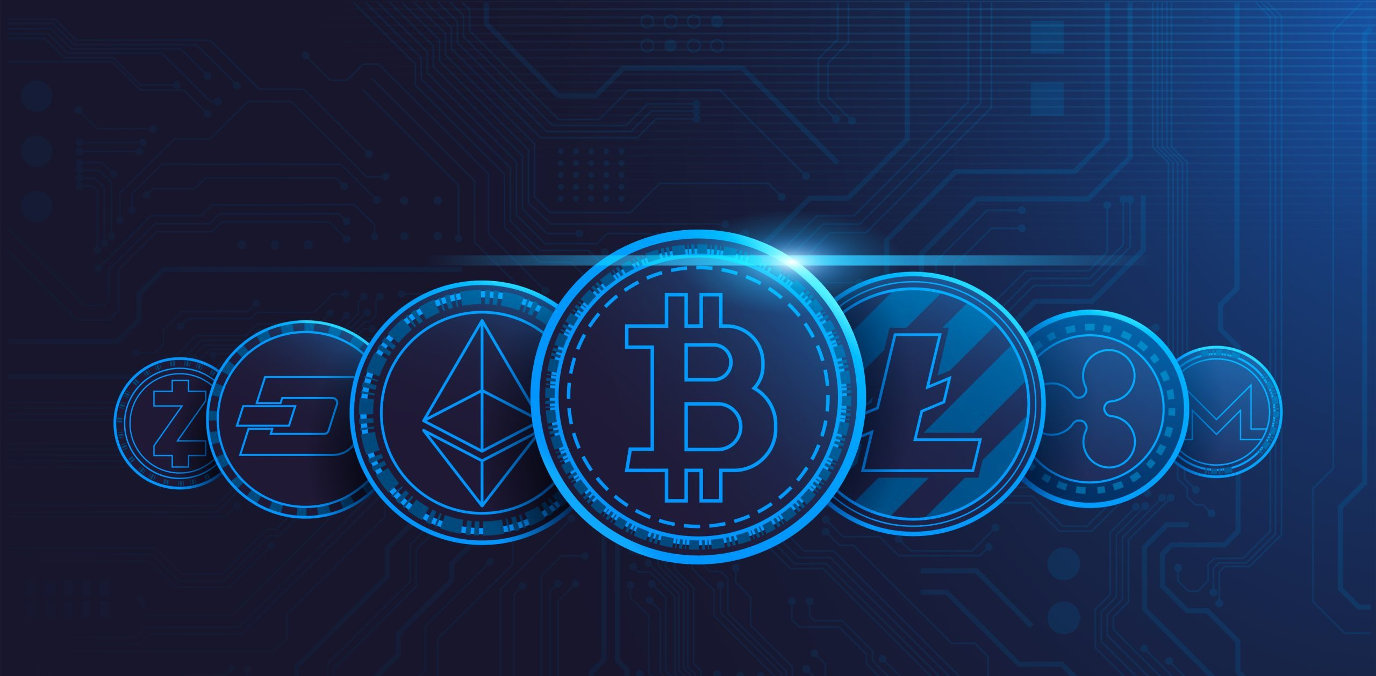
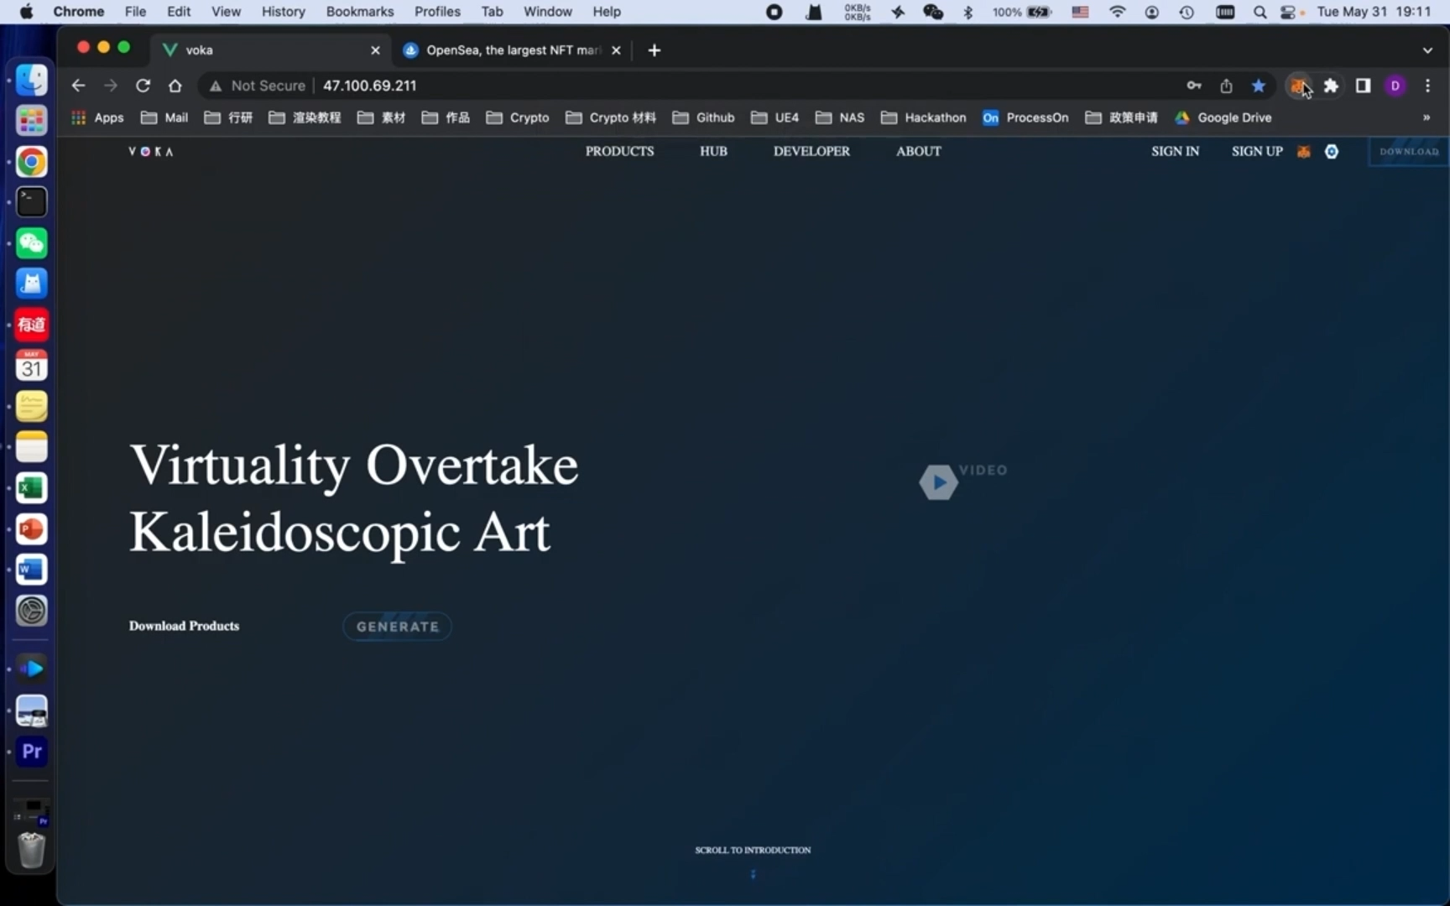
Ai avatar generator
AI avatar generator
Notes:
Business Model Sketch Map

Slide 5
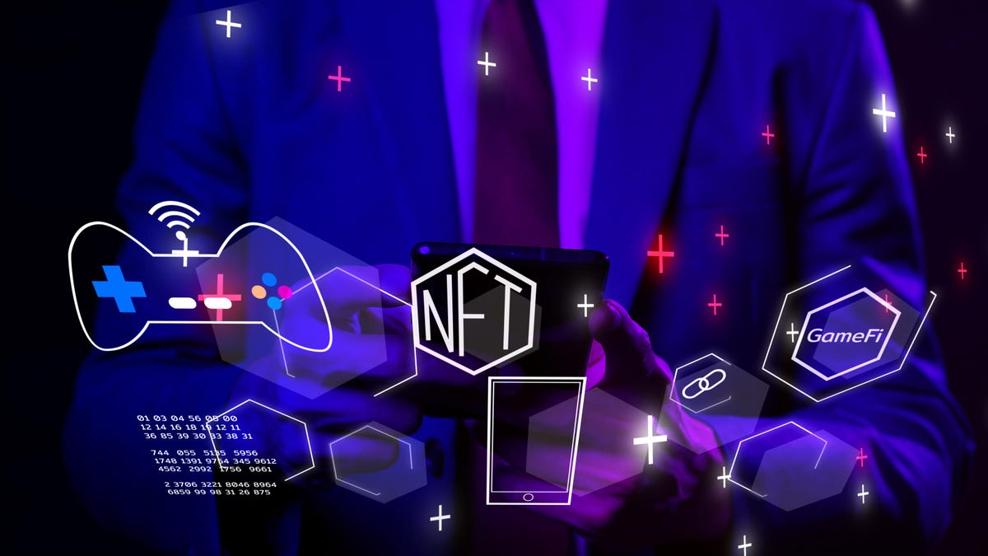
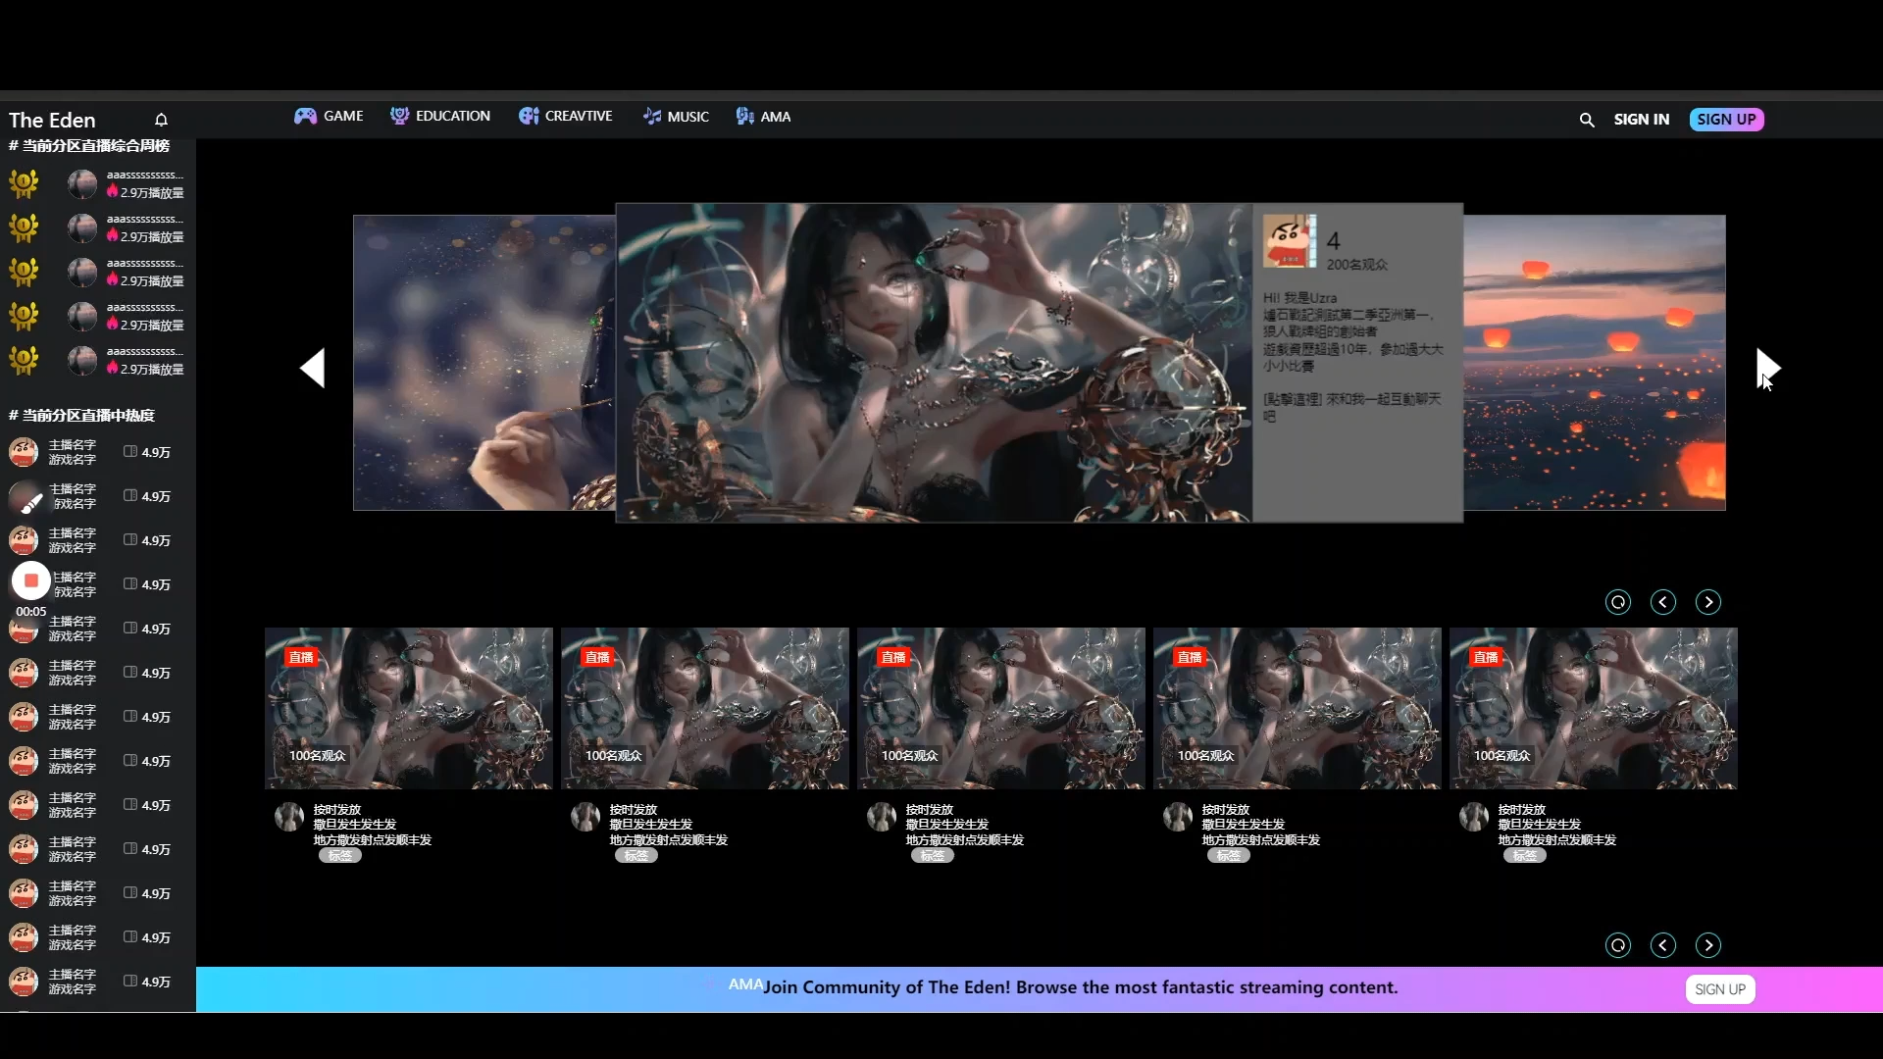
Live-streaming platform
Live-streaming platform
Notes:
Experience Management System How to get

Slide 6
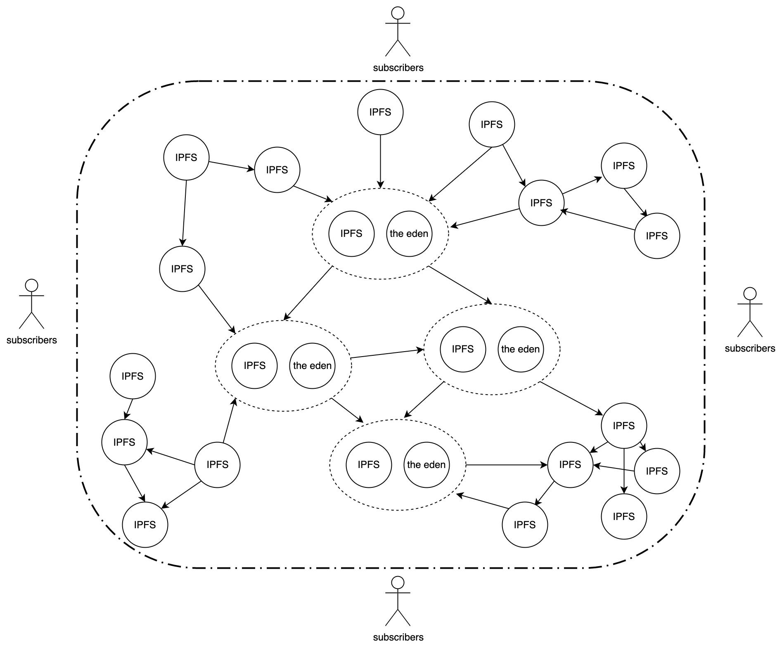
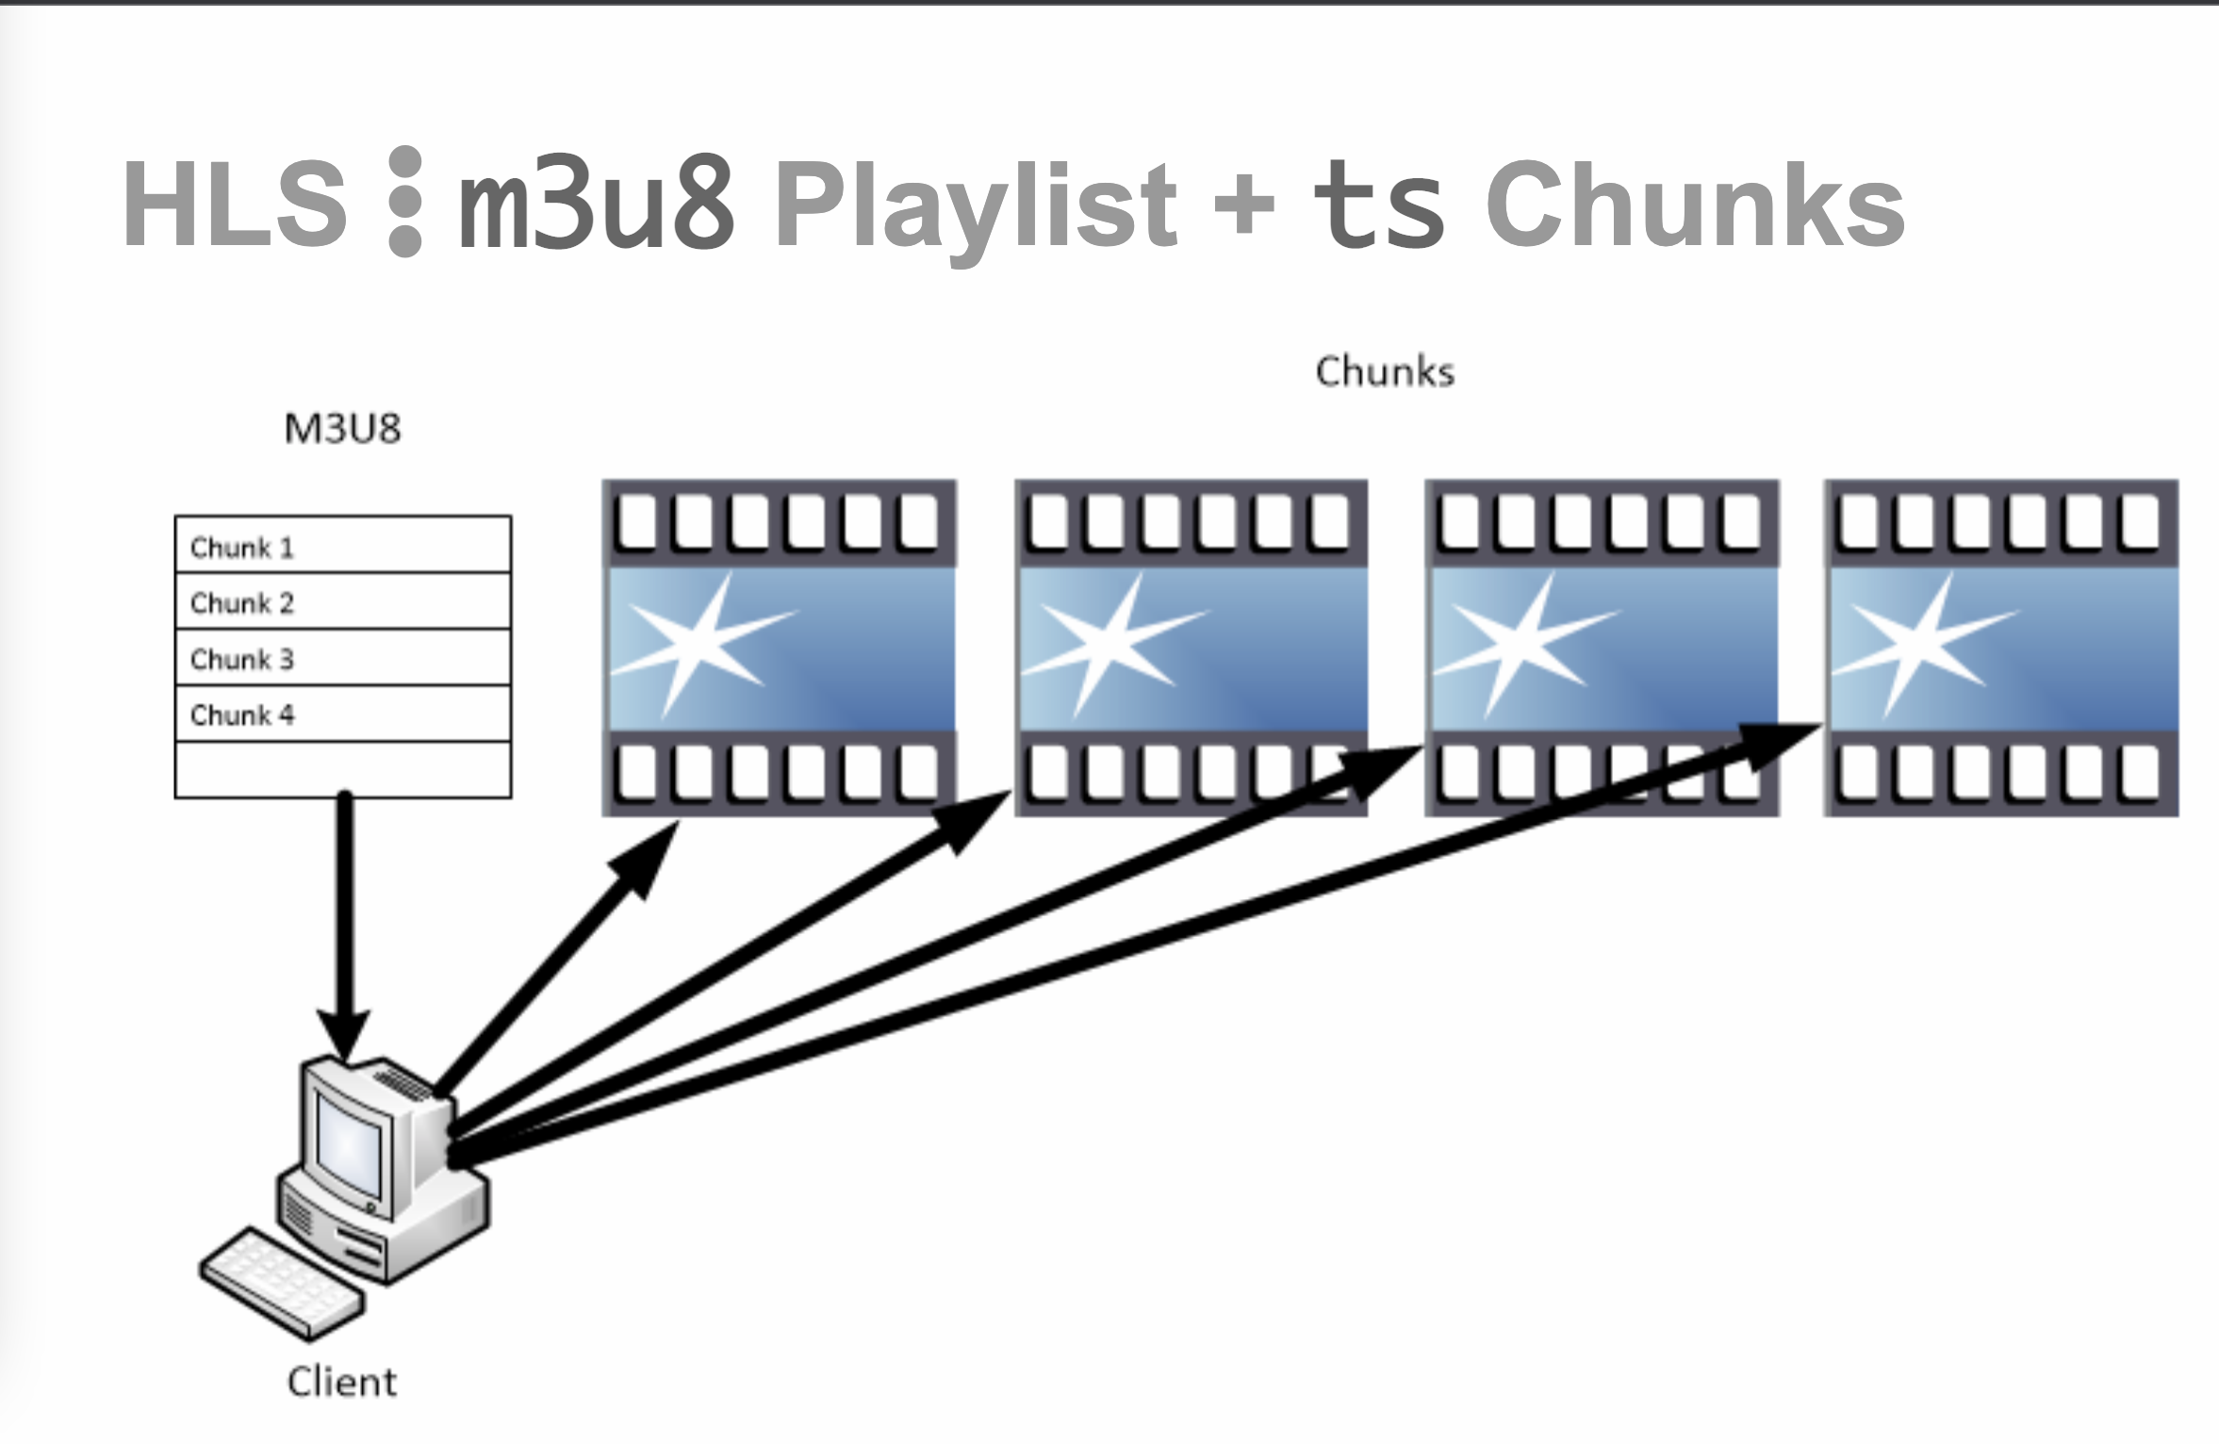
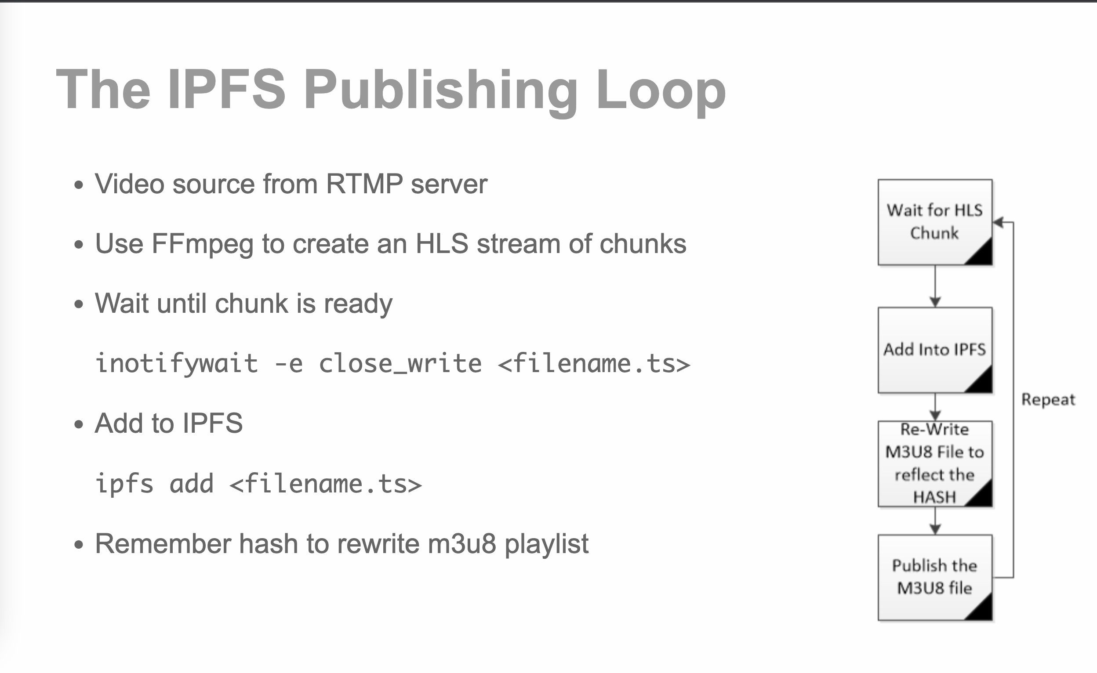
RTMP+IFPS Server
RTMP+IPFS Server
Notes:
Behind the Story

Slide 7




Contact us
Contact us
Dennis HUANG
Telegram: dennishuang85
Email : dennishuang85@icloud.com
VOKATech
https://github.com/VOKA-AI
https://youtu.be/8pxsrmOZIFQ
Notes:
End

